Slide 1




So You Want to go Into IT? The best cities to look and why
By Joshua E. Powell

Slide 2

Top IT Jobs by Region
Computer systems analyst
Information security analyst
Computer programmer
Software systems developer
Web developer
Database administrator
Computer network administrator
Computer network architect
Midwest
West
South
South
South
Midwest
South
Northeast

Slide 3

Top 10 Cities for IT
Seattle, Washington
Atlanta, Georgia
Salt Lake City, Utah
Minneapolis, Minnesota
Hartford, Connecticut
St. Louis, Missouri
San Francisco, California
Miami, Florida
Pittsburgh, Pennsylvania
Boston, Massachusetts

Slide 4



Seattle, Washington
Most Common Job – Computer Programming
Top IT Salary - $129,470
Avg Cost of Living – 10.5% above norm(expensive)
Actual Income - $117,167
WHY?
Over the Past 30 yrs.
Experience 12% growth each year
43% increase in IT jobs and 18% increase in STEM jobs
Expensive to stay there but 814 people are hired daily.
Average income

Slide 5
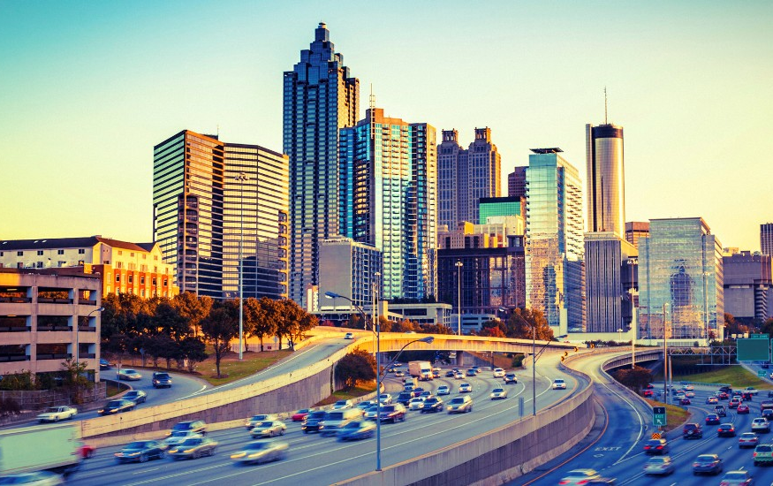

Atlanta, Georgia
Most Common Job – Computer Network Architect
Top IT Salary - $114,100
Avg Cost of Living – 3.7% below norm(affordable)
Actual Income - $118,484
WHY?
Employs 947 per 100,000 new hires
Most people employed in the IT field
Cost of living is great
Ranked 1 in the best state to live if you have student debt

Slide 6
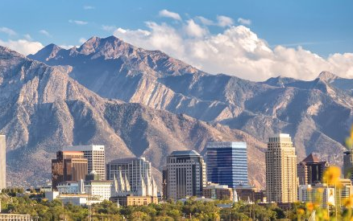

Salt Lake City, Utah
Most Common Job – Database Administrator
Top IT Salary - $97,300
Avg Cost of Living – 0.6% below norm(affordable)
Actual Income - $97,918
WHY?
Powerful alternative to Silicon Valley
Companies flock to UT b/c of:
Low taxes
Well educated
Flexible regulatory environment
Diverse workforce
Natural amenities

Slide 7






DO YOU!!! GET OUTSIDE THE BOX
THRE3 KINGZ
Snapchat: greatmindhuncho & twin_wildin
Instagram: greatmindsince95
Twitch: Coming soon…
Discord: Coming soon…
YouTube: Coming soon…
And More to Come…

Slide 8
References:
Kirkham, E. (2018, 12 03). Rankings: The 100 Best Cities to Work in Tech. Retrieved from Student Loan Hero: https://studentloanhero.com/featured/best-cities-to-work-in-tech/
Kotkin, J. (2012, 05 17). The Best Cities For Tech Jobs. Retrieved from Forbes: https://www.forbes.com/sites/joelkotkin/2012/05/17/the-best-cities-for-tech-jobs/#73d1c63932a3
Swanner, N. (2019, 02 15). These are the Best and Worst Cities for Tech Jobs in 2019. Retrieved from Dice: https://insights.dice.com/2019/02/15/best-worst-cities-tech-jobs-2019/
MYSELF!!!

